Slide 1
CSC-335 HCI & Computer Graphics
Lec 1: Introduction

Slide 2
Human Computer Interaction
What is HCI?

Slide 3
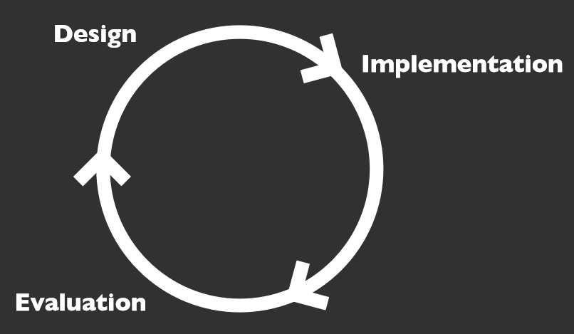
Human Computer Interaction
What is HCI?
Working in quick iterations so we can figure out problems sooner rather than later

Slide 4
Human Computer Interaction
What is HCI?
What makes a design a good design?
What makes it a bad one?
What is one factor which is central to all interaction design?
Notes:
Bad design: Costs lives, money and time.
Good design: Often, the interface in a good design will in a way become invisible to you, as in, you will not be thinking about it.

Slide 5
User Centered Design
Design with people in mind; people’s tasks, goals, and values should drive your development
Work with users throughout the process
Assess decisions from the users’ point of view, their work and their environment
Pay attention to people’s abilities and situations

Slide 6
What is a good User Experience?

Slide 7
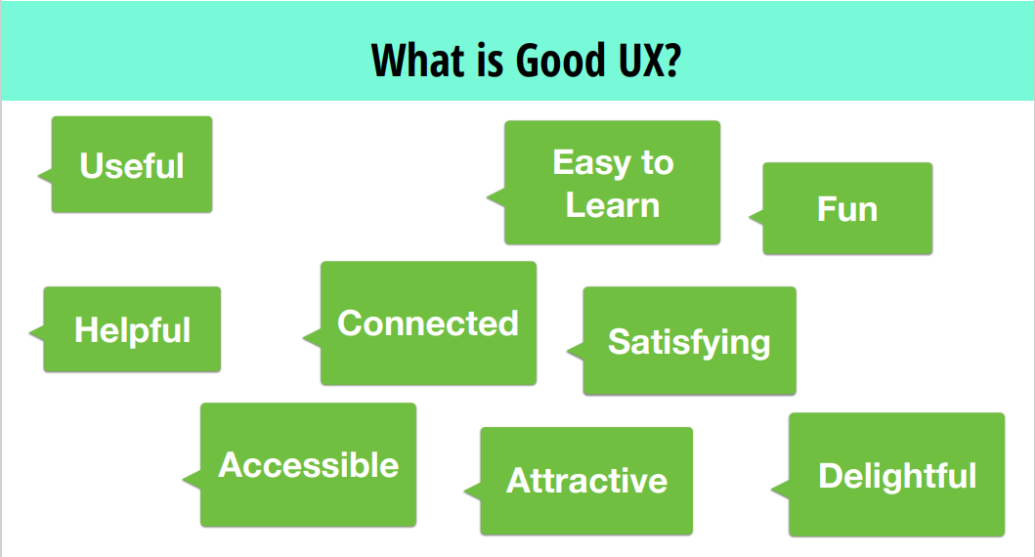
What is a good User Experience?

Slide 8
What is a bad User Experience?

Slide 9
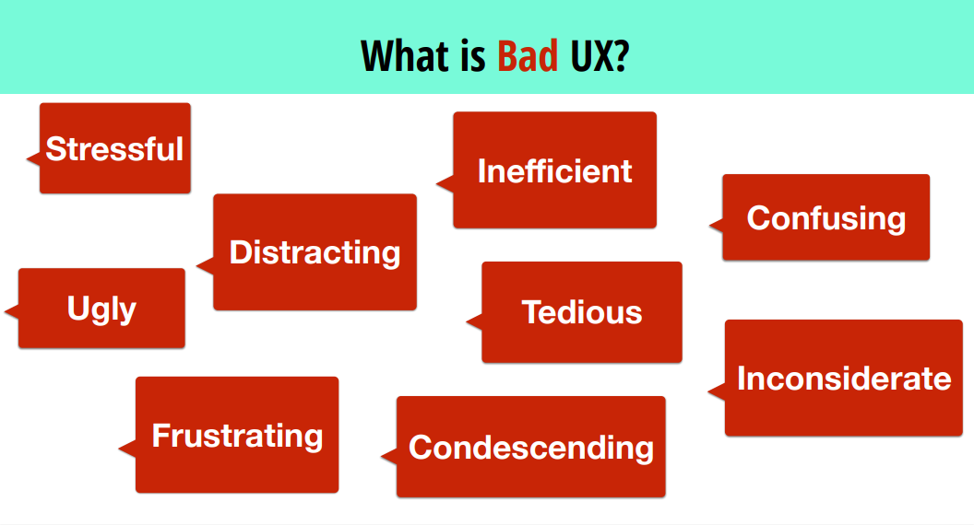
What is a bad User Experience?

Slide 10
Why does it matter?

Slide 11
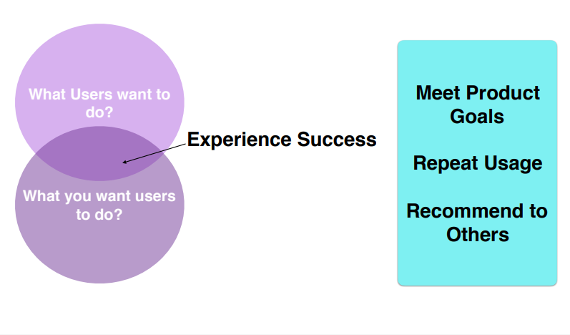
Why does it matter?

Slide 12
The UX as a whole?
UX is the experience people have when they interact with your product
Using the product
Choosing it
Acquiring
Learning to use it
Fixing the product
Upgrading the product

Slide 13
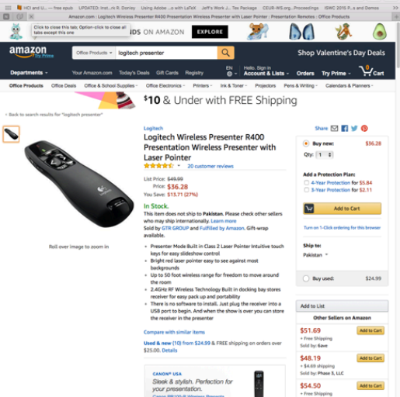
Example - 1
Amazon.com
Buy Stuff
Enjoy Stuff
Come back again
Recommend to others

Slide 14

Example - 2
Bnu.edu.pk
Find information
Understand Programs
Streamline admission services
Recommend to Others

Slide 15

Example - 3
Glucometer
Improve health
Do no harm
Convince providers
Recommend to others

Slide 16
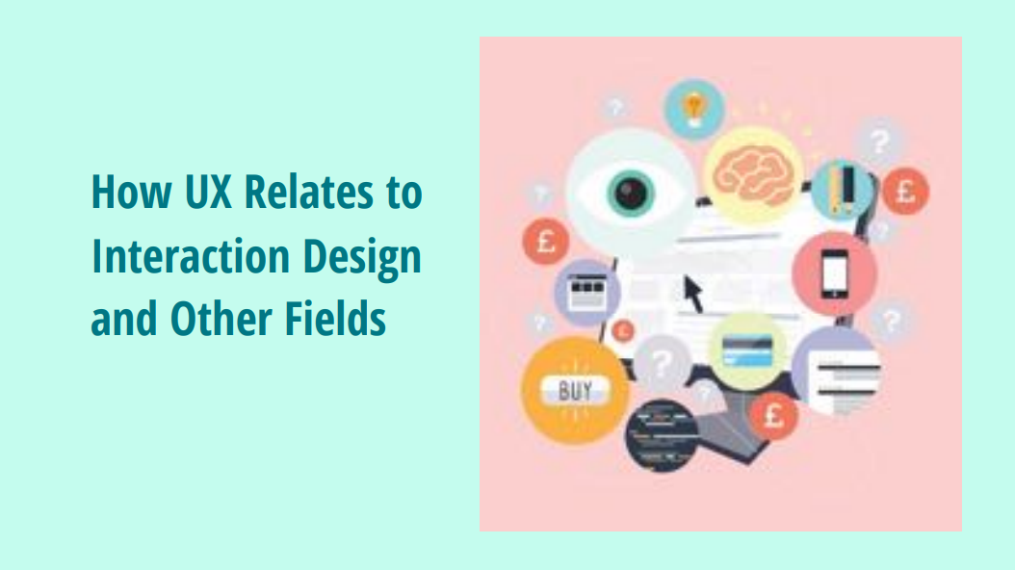

Slide 17
Interaction Design
What is Interaction Design?
Develop interactive products that are usable
Easy to learn
Effective to use
Enjoyable user experience
Goal of Interaction Design
Develop usable products
Usability means easy to learn, effective to use and provide an enjoyable experience
Involve users in the design process

Slide 18
Which Kind of Design?
Number of other terms used emphasizing what is being designed, e.g.
user interface design, software design, user-centered design, product design, web design, experience design (UX)
Interaction design is the umbrella term covering all of these aspects
fundamental to all disciplines, fields, and approaches concerned with researching and designing computer-based systems for people

Slide 19
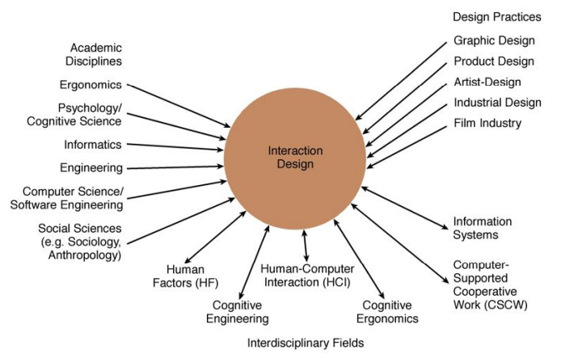
HCI & Interaction Design

Slide 20
What do professionals do in the ID business?
interaction designers - people involved in the design of all the interactive aspects of a product
usability engineers - people who focus on evaluating products, using usability methods and principles
web designers - people who develop and create the visual design of websites, such as layouts
information architects - people who come up with ideas of how to plan and structure interactive products
user experience designers (UX) - people who do all the above but who may also carry out field studies to inform the design of products

Slide 21
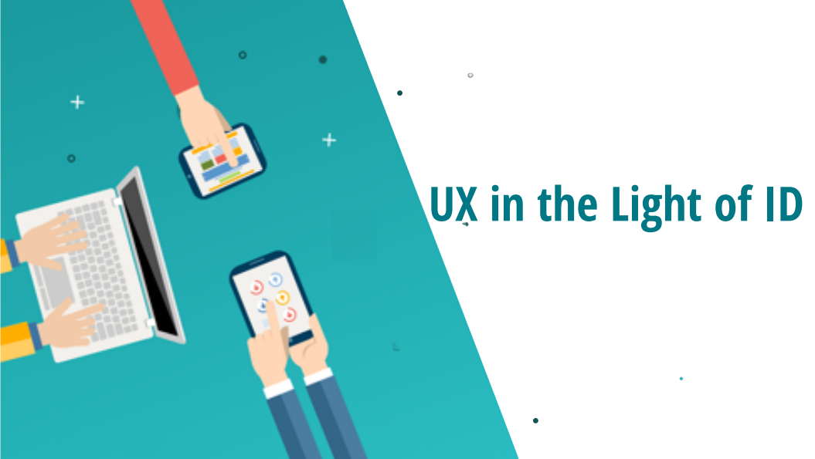

Slide 22
User Experience
How a product behaves and is used by people in the real world
The way people feel about it and their pleasure and satisfaction when using it, looking at it, holding it, and opening or closing it

Slide 23
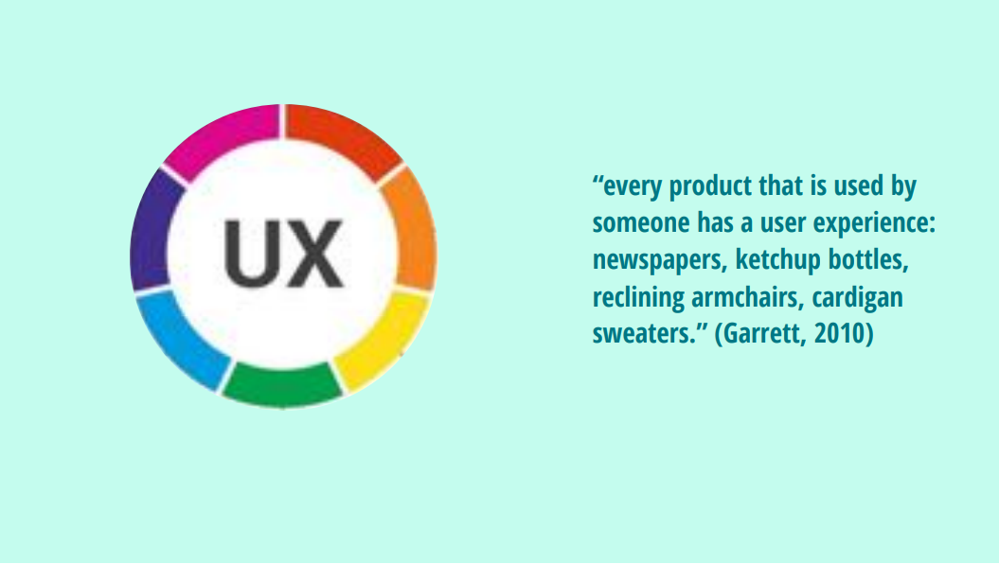

Slide 24
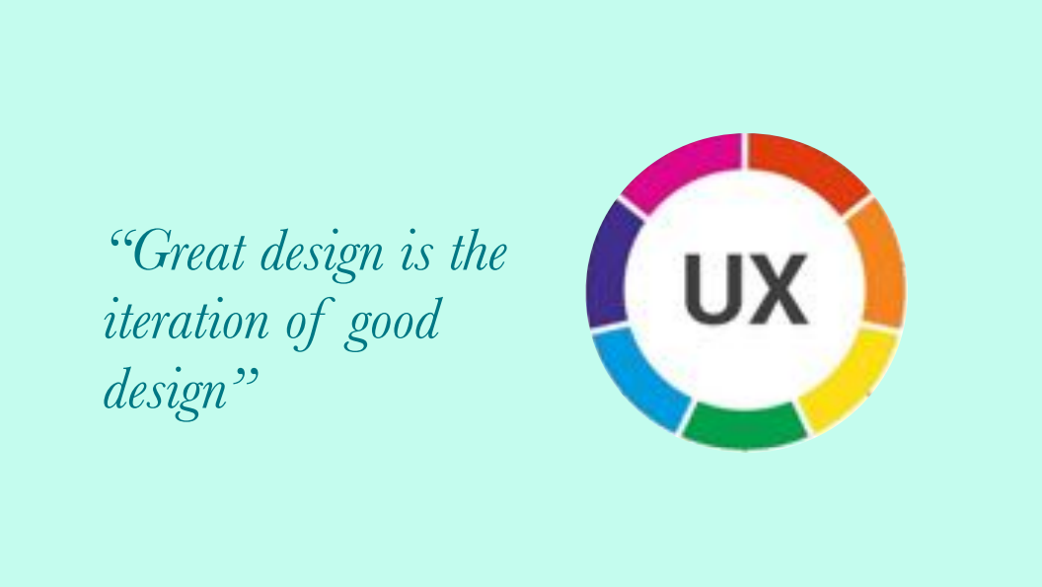

Slide 25
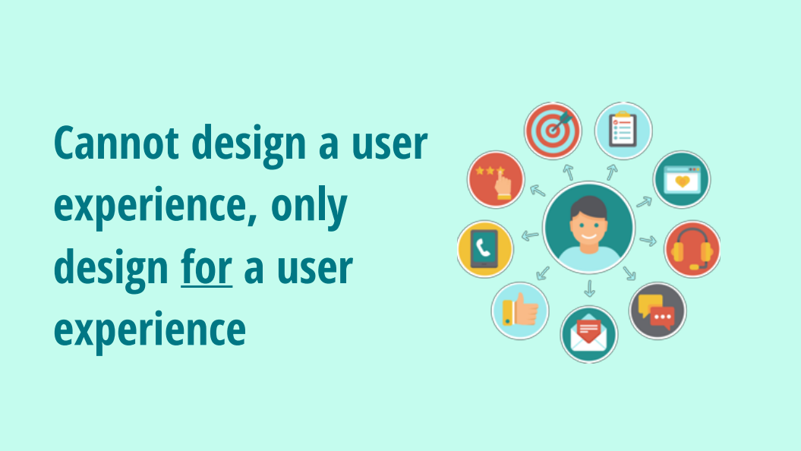

Slide 26
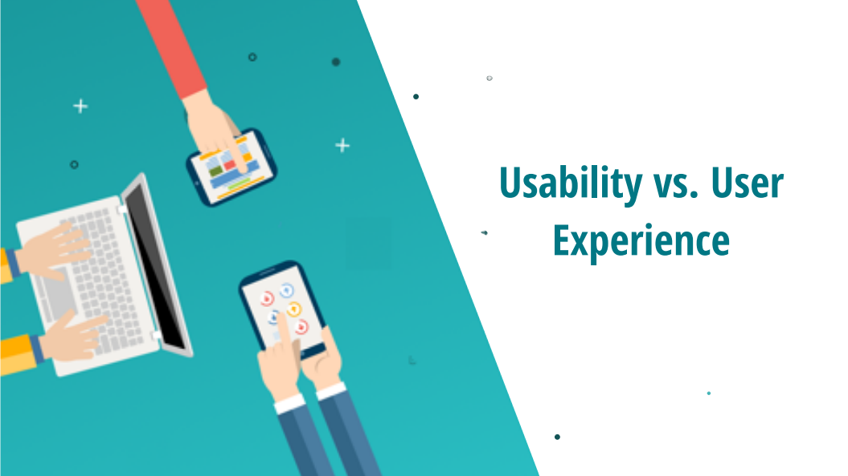

Slide 27
Usability vs. User Experience
“Usability is the extent to which a product can be used by specified users to achieve specified goals with effectiveness, efficiency and satisfaction in a specified context of use.“ - Definition of Usability DIN EN ISO 9241-11

Slide 28
Is Usability enough?
Fulfilling this definition leads to:
Products that do not prevent users from performing their tasks
Products that can be used effectively and efficiently
Products that do not annoy users
Is this really sufficient to build great products that users enjoy to use?

Slide 29


Slide 30


Slide 31


Slide 32


Slide 33
User Experience is more than just Usability!
Product related User Experience Factors
User Experience is influenced by a lot of different factors
Some of them are actual product related factors like
features or quality attributes
Other factors concern: the brand, the image, the packaging, marketing
Can you think of any other factors?

Slide 34
User Experience - Formally Defined!
“User experience includes all aspects of the user’s experience when interacting with the product, service, environment or facility.
It is a consequence of the presentation, functionality, system performance, interactive behavior, and assistive capabilities of the interactive system.
It includes all aspects of usability and desirability of a product, system or service from the user’s perspective.”

Slide 35
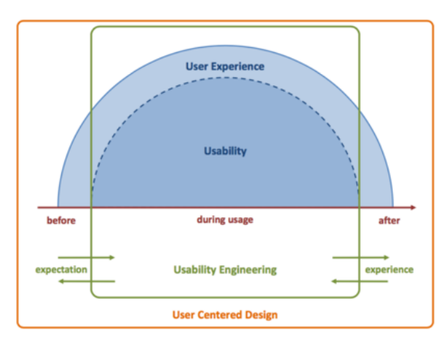
User Centered Design - Relationships

Slide 36
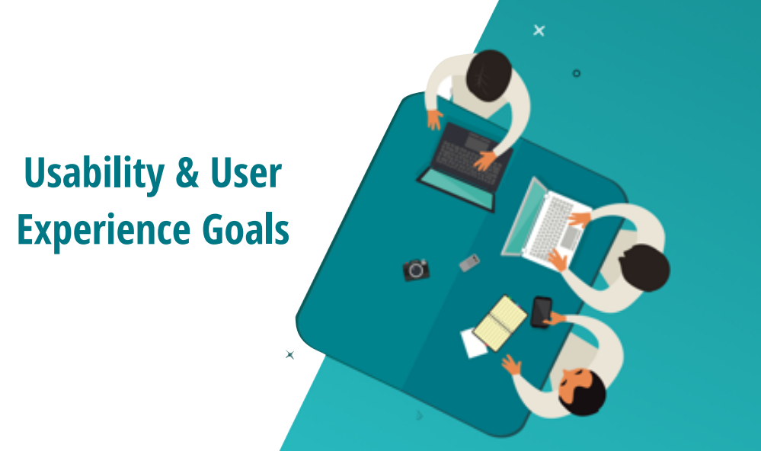

Slide 37
Usability Goals
Effective to use
Efficient to use
Safe to use
Have good utility
Easy to learn
Easy to remember how to use

Slide 38
User experience goals
Desirable Aspects
Undesirable aspects

Slide 39
User experience goals
Desirable Aspects
satisfying helpful fun
enjoyable motivating provocative
engaging challenging surprising
pleasurable enhancing sociability rewarding
exciting supporting creativity emotionally fulfilling
entertaining cognitively stimulating
Undesirable aspects
boring unpleasant
frustrating patronizing
making one feel guilty making one feel stupid
annoying cutesy
childish gimmicky

Slide 40
Balancing Usability and user experience goals
Selecting terms to convey a person’s feelings, emotions, etc., can help designers understand the multifaceted nature of the user experience
How do usability goals differ from user experience goals?
Are there trade-offs between the two kinds of goals?
e.g. can a product be both fun and safe?
How easy is it to measure usability versus user experience goals?

Slide 41
How has the way humans interact with computers changed over time?
&
why does that matter for UX/UXE today?

Slide 42
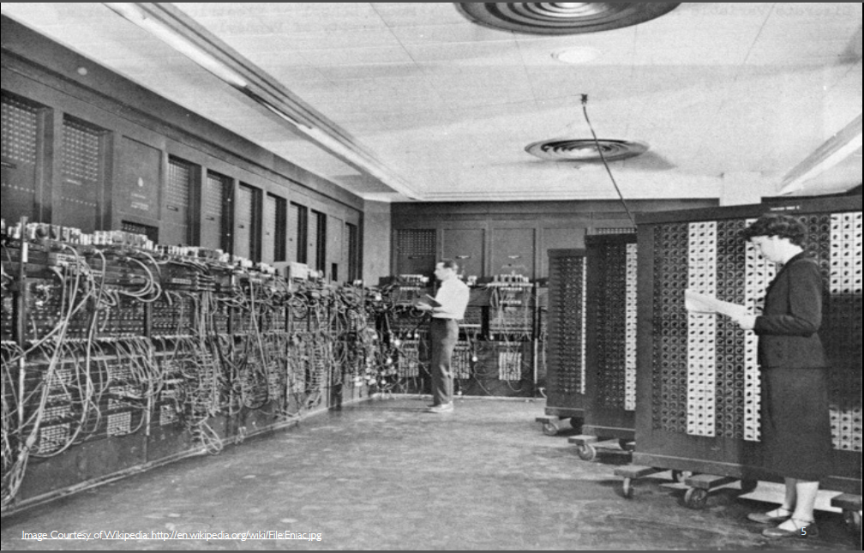
Timeline - 1
Early Computing aka Batch Processing
No Interaction
Model: Submit -> wait -> get output
eg: Punch cards & Mainframes
UX Issue:
No real-time feedback
No usability concept yet
Notes:
Computers were not interactive — they were calculation machines

Slide 43
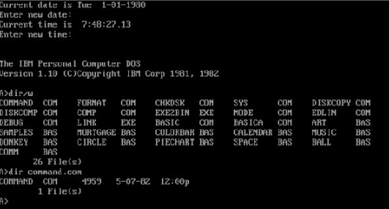
Timeline - 2
Command Line Interaction (CLI)
Model: Text commands
eg: DOS, Linux terminal
UX issues:
Expert users only
Memorization required
Low discoverability
Cognitive load is high
Learnability is low

Slide 44
Timeline - 3
GUI/WIMP Paradigm
Model: GUI or Windows, Icons, Menus, Pointer
eg: Windows, MacOS, Desktop apps
UX issues:
Visual interaction replaces memorization
Discoverability increases
Affordances matter
Direct manipulation begins
Heuristics & usability principles emerge
Notes:
Affordance:
When we moved from command typing → visual interaction, interfaces had to visually communicate available actions.

Slide 45
Timeline - 4
Web & Hyperlink Paradigm
Model: Navigation-based interaction
eg: websites & browsers
UX impact:
Shift from applications to information spaces
Information architecture becomes critical
Navigation matters
Consistency becomes key
Notes:
Information architecture: how information and features are structured, organized, and labeled so users can find and understand them easily.
It has 4 main parts: organization, labelling, navigation, search

Slide 46
Timeline - 5
Touch & Mobile Paradigm
Model: Direct touch manipulation
eg: smartphones & tablets
Shift:
UX consequences:
Pointer to finger
Target size matters
Gesture discoverability issues eg: swipe left to archive in Gmail
Context-aware UX
Context-aware:
Location: map reccs
Time: apps show breakfast items in the morning
Behavior: most recently used apps shown first
Orientation: portrait vs landscape
Notes:
Fitts’ Law: Closer + Bigger = Faster to hit ||| Farther + Smaller = Slower + more errors
Target size matters: Users should hit targets comfortably — not surgically.

Slide 47
Timeline - 6
Voice & Conversational Interfaces
Model: Natural language interaction
eg: Alexa, Siri, Chatbots
UX challenges:
Interface disappears
No visual affordance: don’t know what actions are possible
Feedback is invisible: eg: Voice assistant pauses for 3 seconds.
Error recovery is harder, no way of going back etc

Slide 48
Timeline - 7
What timeline are we entering now?

Slide 49
Timeline - 7
AI & Adaptive Interfaces (Current Shift)
Model: System adapts to user
eg: ChatGPT, AI copilots, recommendation systems
UX implications:
User no longer fully controls flow
Trust becomes key
Transparency matters
Explainability needed
Ethical UX required

Slide 50
Timeline Summary
Each paradigm shift changed:
How users think
What designers must optimize
What engineers must implement
UX rules are not static — they evolve with interaction paradigms

Slide 51
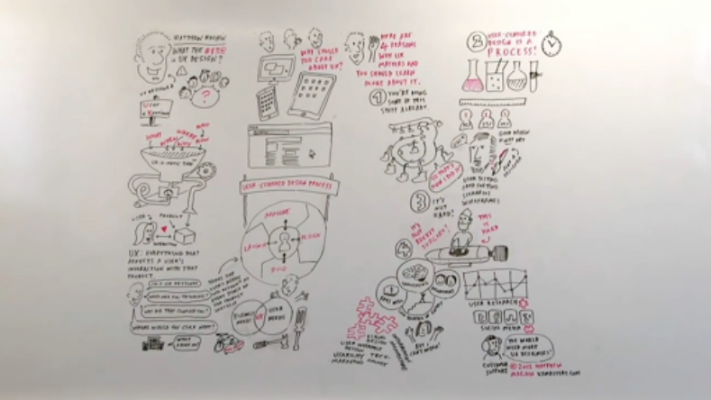
Summary
https://www.youtube.com/watch?v=Ovj4hFxko7c

Slide 52
Any Questions?

